Slide 1

When your day begins…

Slide 2
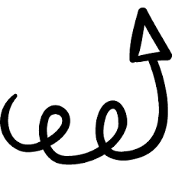
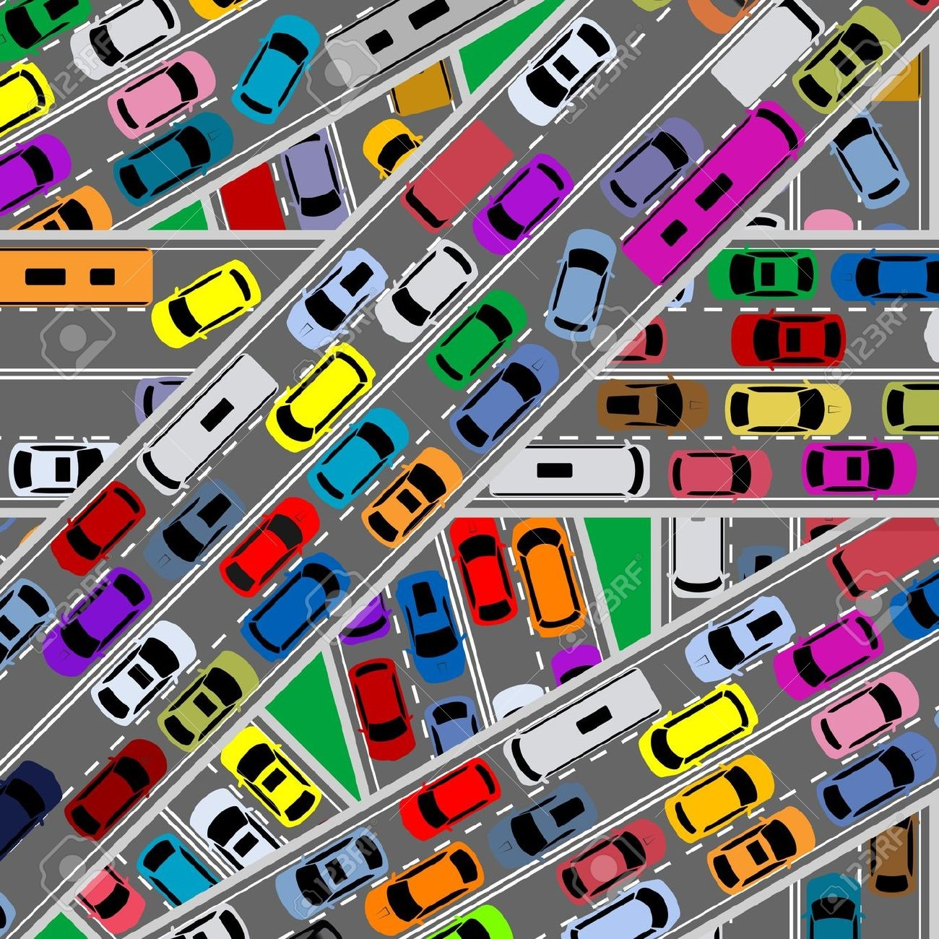
You get on the road and get in line for the freeway…

Slide 3
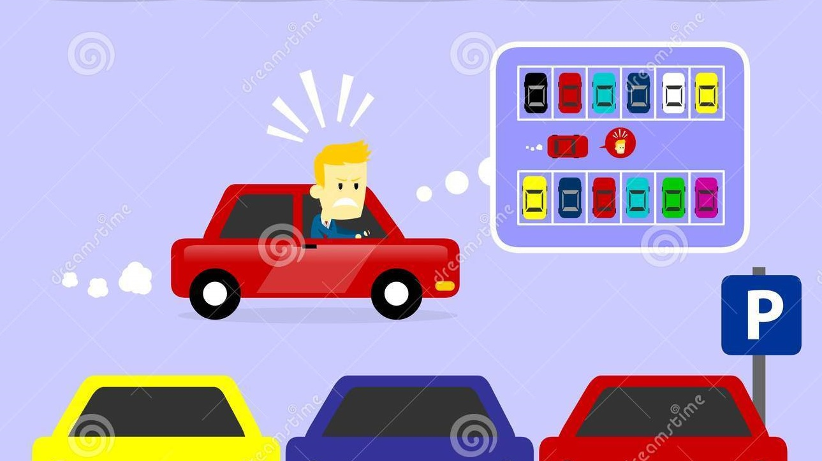
You come to school and wait in line to find a parking spot to park…

Slide 4
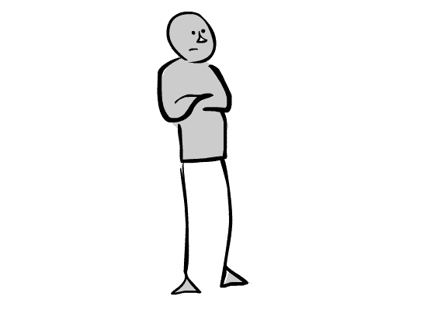

You go to the bookstore and wait in line to make your purchase or pick up an ordered book…

Slide 5
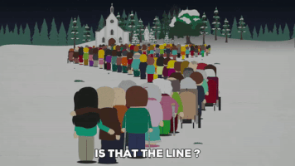
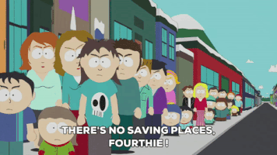
You are going to need some money, so you go to the bank and again you wait in line…
You get out of school and you want to go out.

Slide 6
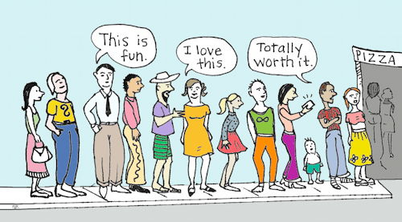
Maybe you go out to eat dinner. You get to the restaurant and…again, you wait in line, for a table…

Slide 7
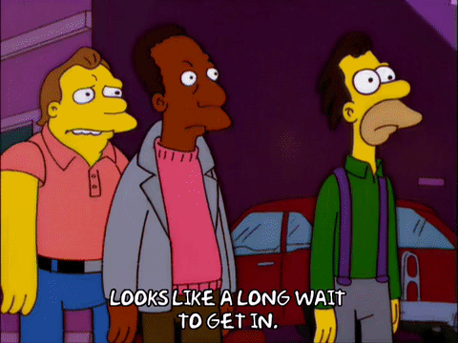

Maybe you go to a concert or a sports event, so you go to the ticket booth, and again you get in line and wait…

Slide 8
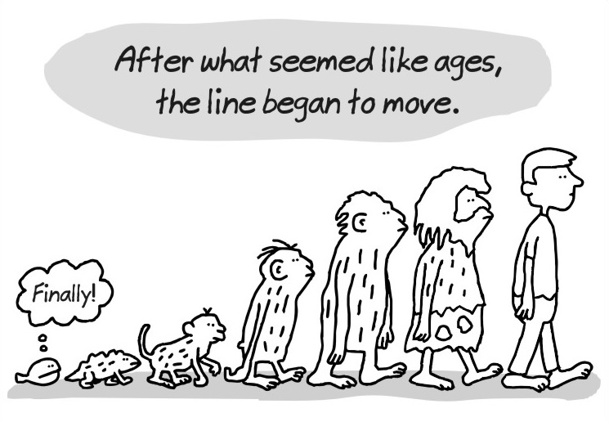
We do an awful amount of waiting, waiting in line…This is understandable, the amount of people for each event or each transaction is always increasing. And lines are a simple, efficient structure to make these transactions fair for all. But what if we could avoid having to physically be there in line…

Slide 9
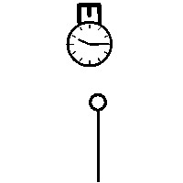
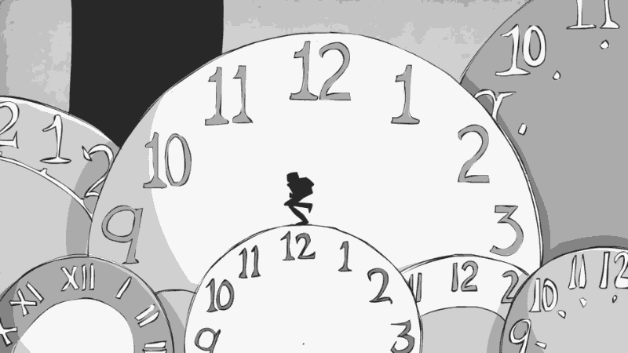
What if we can have someone wait in line for us…so we can free up some of our most valuable asset: time.

Slide 10
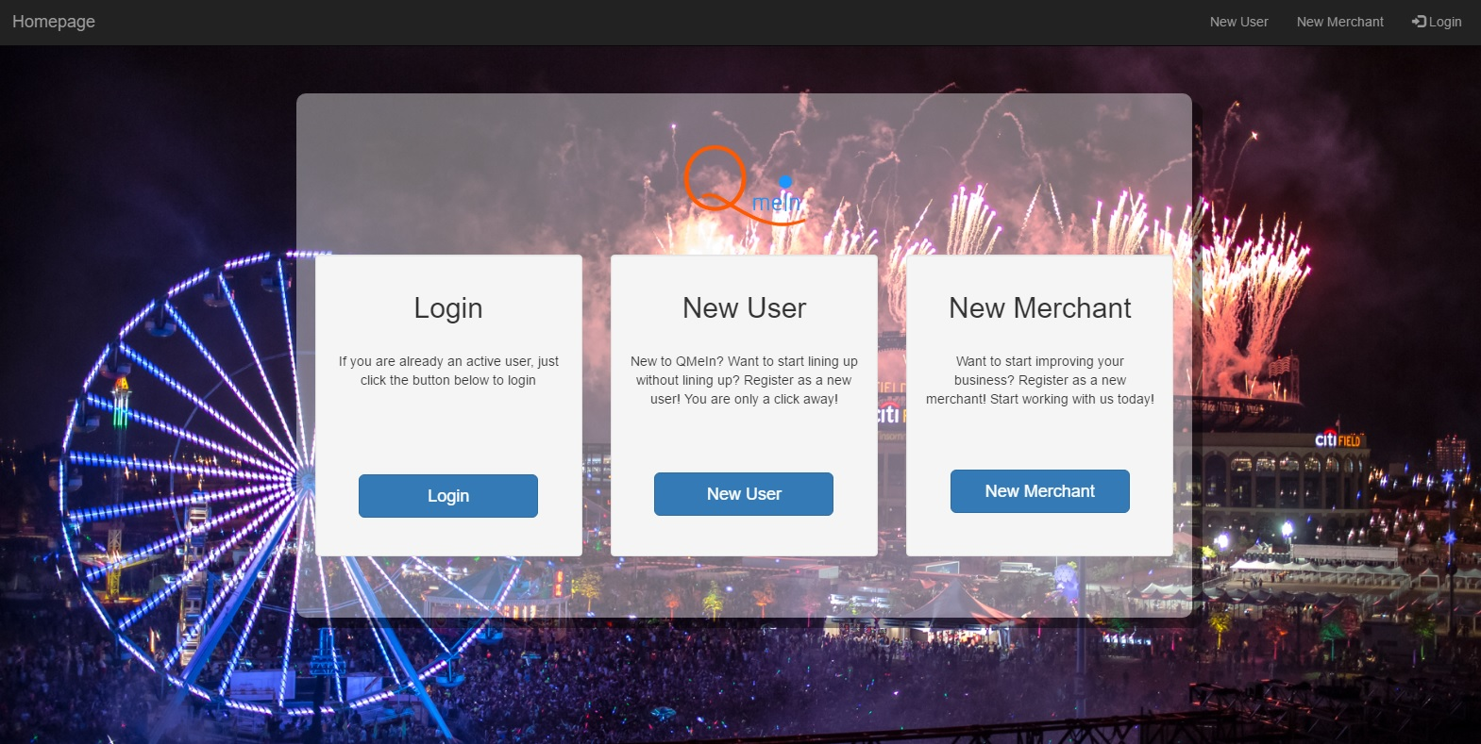
Welcome to QmeIn.
QmeIn is your virtual placeholder. QmeIn waits in line for you, so you can use your time for other meaningful tasks (..Instagram?).

Slide 11
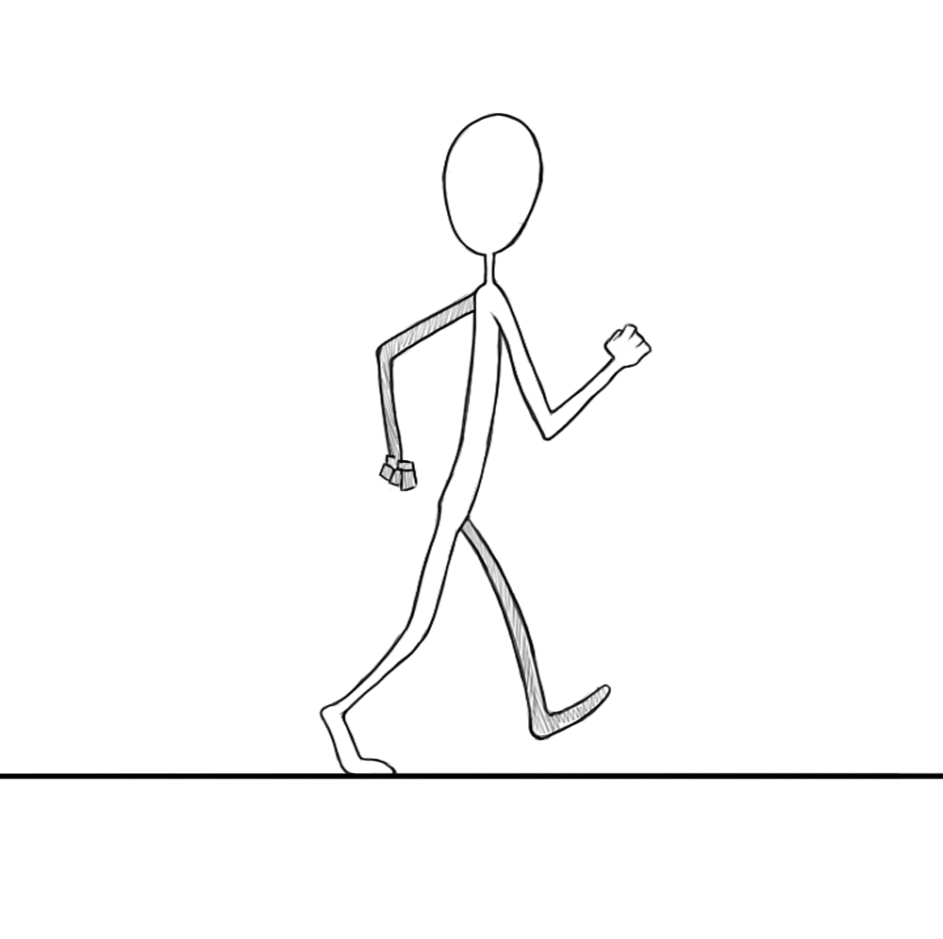
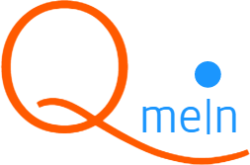
Lets go to the bank with QmeIn.

Slide 12
How about the Titan Bookstore? Lets go there with QmeIn…

Slide 13
No matter where you go, the concept is the same. Its simple: 1. Choose a location. 2. Queue yourself in. 3. When you are 3rd in line, get a text. 4. Go to your location, complete your transaction.

Slide 14
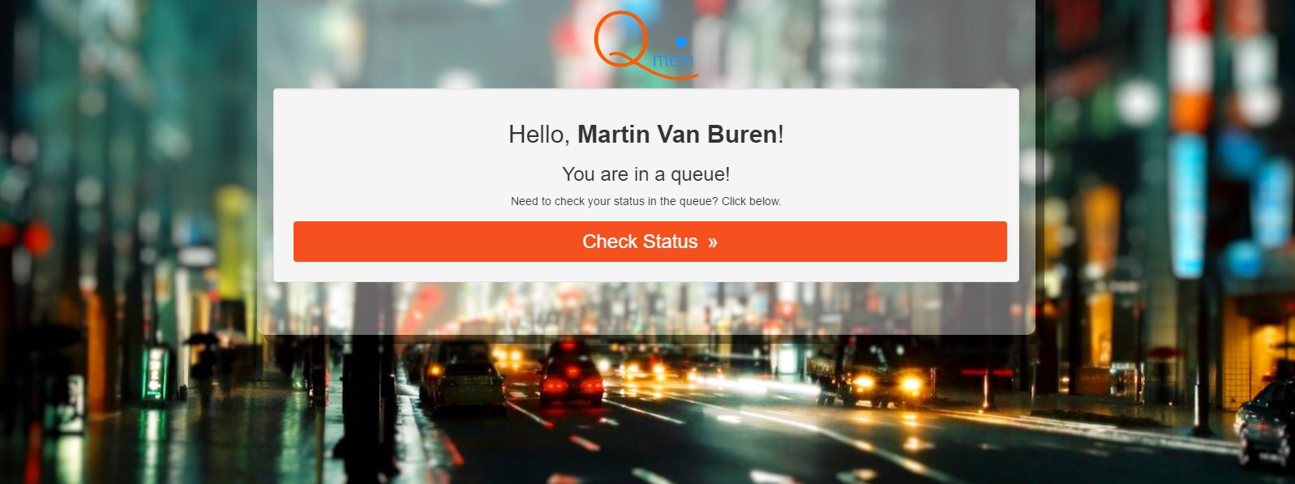
Want to know how many people are in line before your ‘Q’ yourself in? No problem, check queue status.

Slide 15
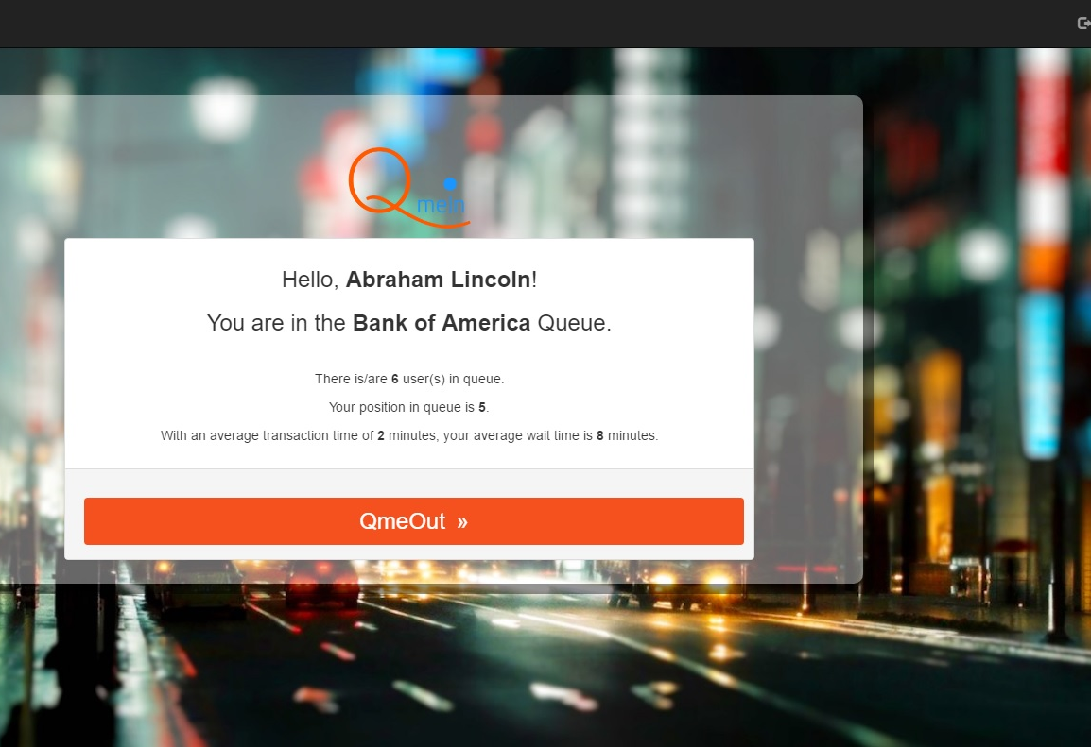
When you are physically in line somewhere, you can just decide to walk away from it. Can you do that with QmeIn? Absolutely. Just hit QmeOut and you are out of line.

Slide 16
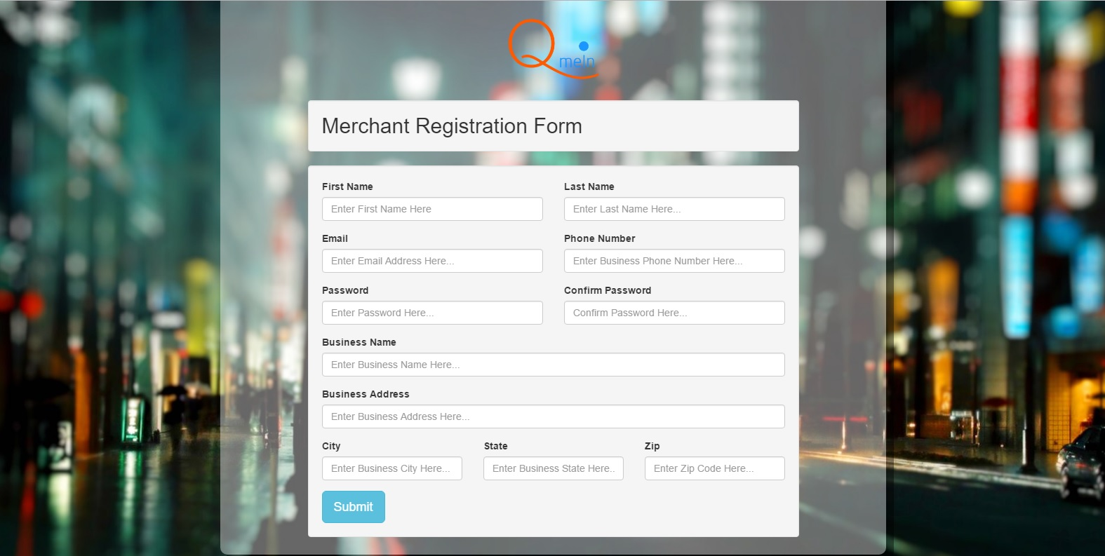
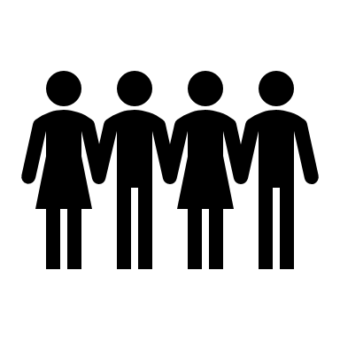
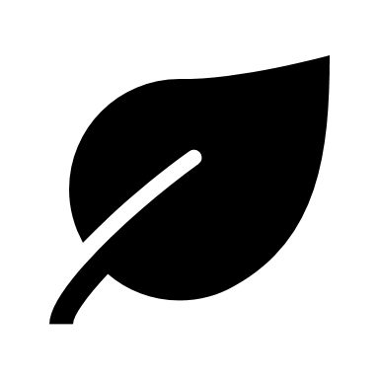
What if you are a merchant? How do you manage this virtual queue?

Slide 17
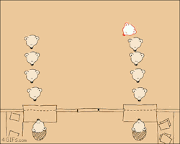
The steps are minimal, even more than for a user: 1. Log in and see a list of people in queue. 2. Complete the transaction and hit the complete button. 3. Repeat step 2 till there are no more people in line.

Slide 18
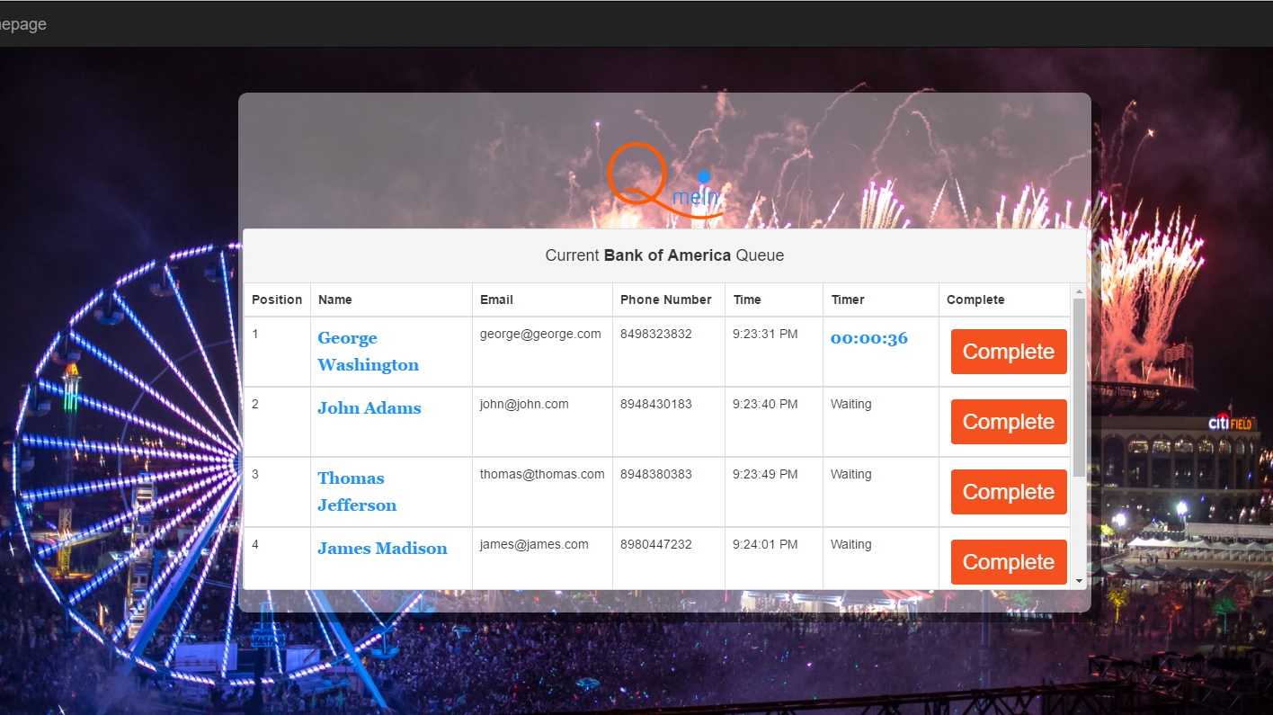
Why would merchants want a virtual queue? DATA

Slide 19
Data that a merchant will receive: - Transaction time that each user takes. - Average transaction time for a time period (hour, day, week, etc.) - Indication of peak hours, which will pinpoint when more team members are required for transaction. - A correlation of labor hours vs transactions completed.

Slide 20
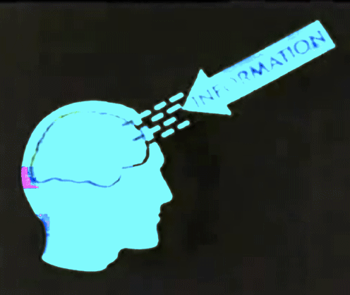
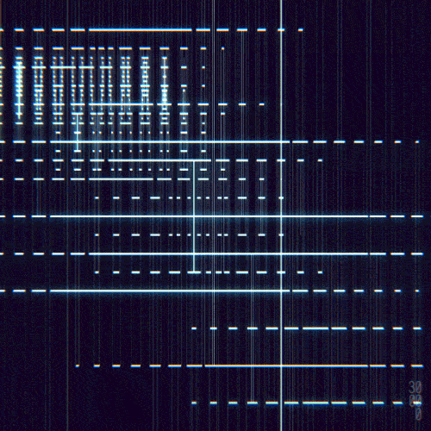
- Indication of when the most amount of people were lost to waiting times which is provided through ‘QmeOut’ data. - Data is costly. Mostly its estimates made through an industry-wide scale. With ‘QmeIn’, the merchant is creating their own data that is precise to their business.

Slide 21
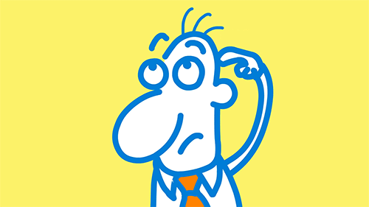
Technology used for development:
Node JS
Express Framework
MongoDB
JavaScript
Handlebars
HTML 5, CSS 3

Slide 22
Node JS - An event-driven application, there is a main loop that listens for events, and then triggers a callback function when one of those events is detected. - Node.js contains a built-in library to allow applications to act as a Web server without software such as Apache HTTP Server. - To scale to large volumes of clients, all I/O intensive operations in Node.js are performed asynchronously. - Node.js is Javascript. So the same language can be used on the backend and frontend. This means it breaks down the boundaries between front- and back-end development.

Slide 23
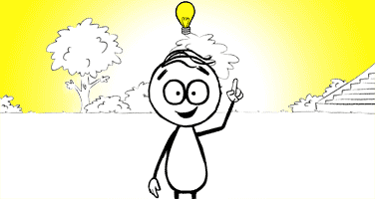
Handlebars - a semantic templating language written entirely in JavaScript. - Logic-less templates do a great job of forcing you to separate presentation from logic. - Clean syntax leads to templates that are easy to build, read, and maintain. - Compiled rather than interpreted templates.

Slide 24
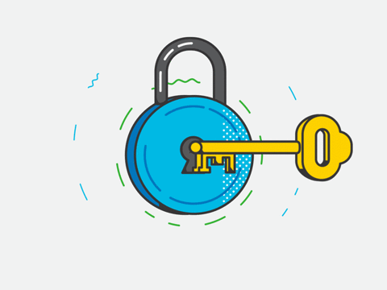
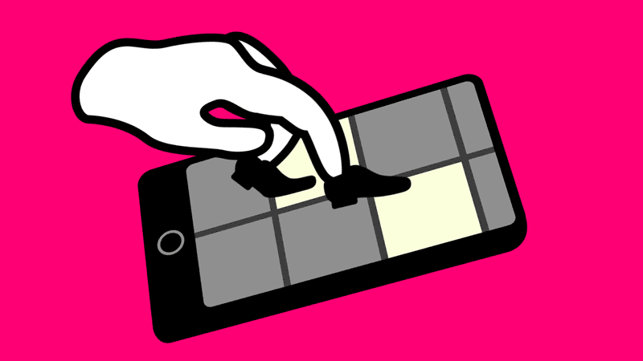
Future development:
Android and Iphone applications for mobile use.

